Slide 1
HOW TO FIND ONLINE JOURNALS/ARTICLES
ACCESS WITHIN CAMPUS
Online databases are accessible to users within UPM campus without using password/EZproxy
Library website
Online
(Database subscription)
Read/ evaluate
Use
Let’s try the following assignment / research topic as an example:
The effects of nutrition package claims, nutrition facts panels, and motivation to process nutrition information on consumer product evaluations
Keywords : nutrition facts, consumer

Slide 2
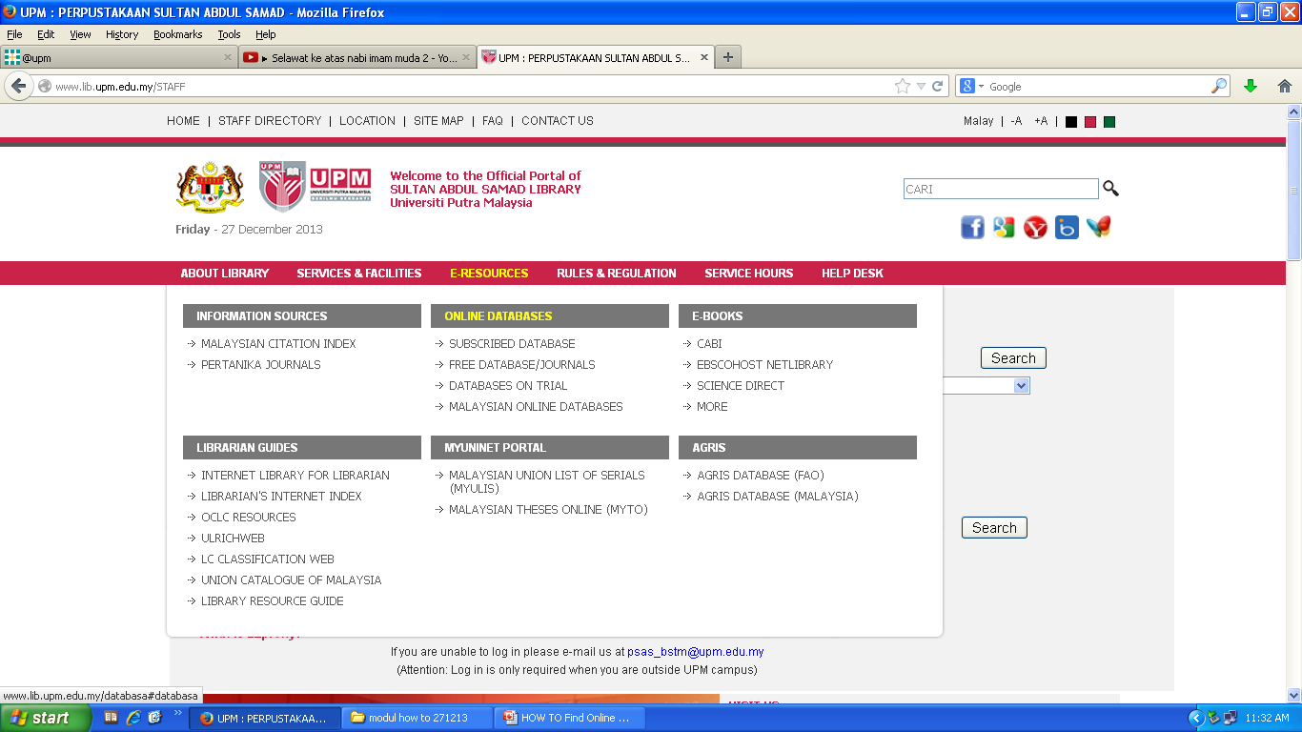
CAMPUS ACCESS
Go Directly to
E- Resources
Click here to begin
Online
Databases
Subscribed Databases/Journal

Slide 3
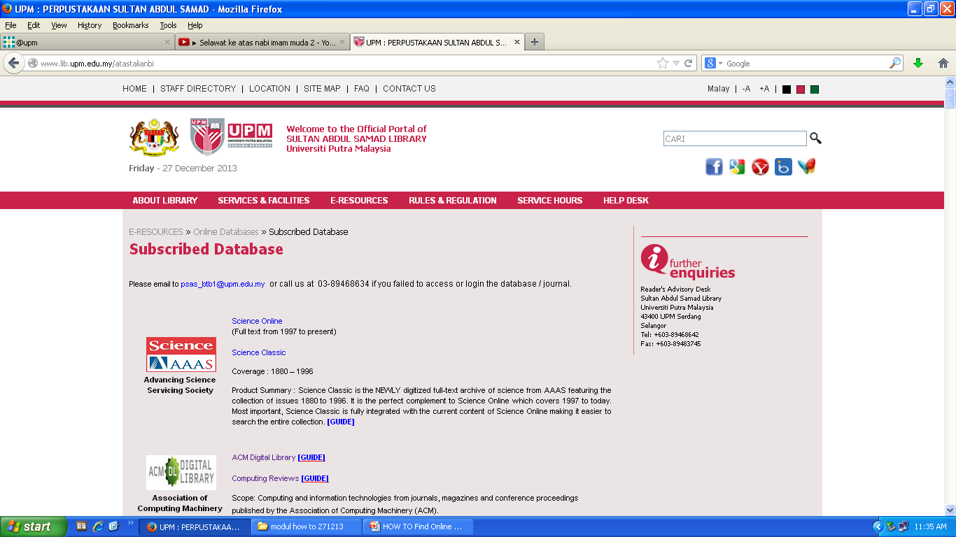
This is the list of databases subscribed by UPM arranged alphabetically. Search in the databases relevant to your topic/subject, e.g. Science Direct.

Slide 4
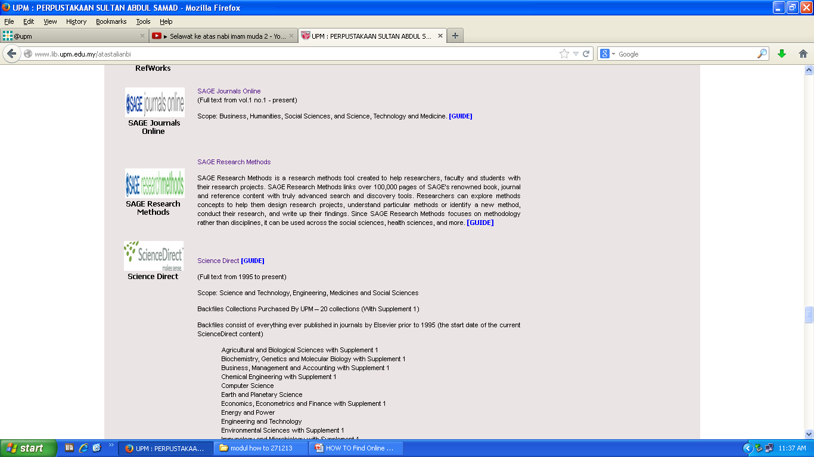
Click on “Science Direct”. You will directly be linked to the related database.
Click here
e.g. Science Direct

Slide 5
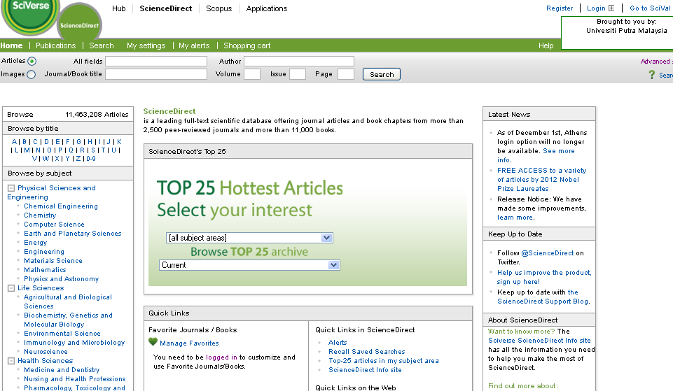
The front page of Science Direct will be prompted.
To begin searching, click on Advanced Search
Click here to begin

Slide 6
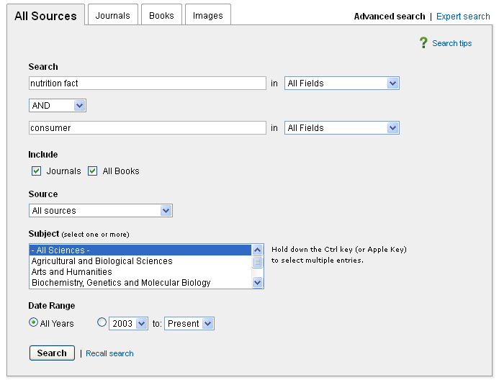
Advanced Search will allow you to combine keywords.
e.g. “nutrition fact” and “consumer”
1
Type in your first keyword
e.g. ‘nutrition fact’
2. Choose appropriate boolean operator
e.g. ‘AND’
Type in your second keyword
e.g. ‘consumer’
4. Click Search.
2
3
4

Slide 7
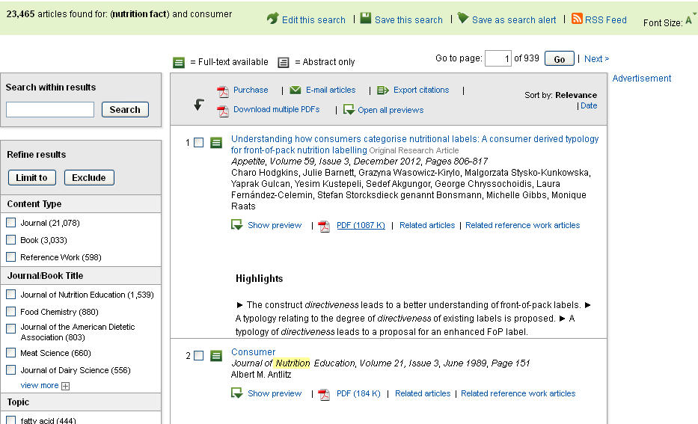
The results page will be displayed.
If the box is green color : articles is full-text , If the box white : only abstract available
Note: Abstract can be viewed by clicking on ‘Show preview’.
Click here to
view the abstract
Click here to download ‘FULL TEXT’ articles

Slide 8
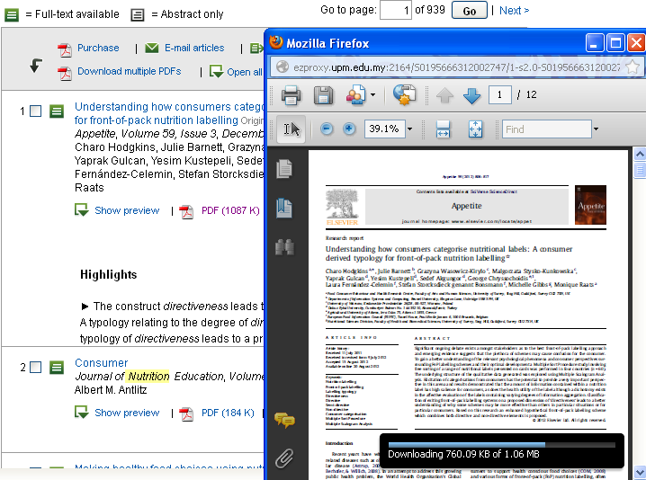
You can save and print the article for your research or assignment.
Back to main page

