Slide 1
HOW TO FIND
RESEARCH PROJECT PAPER
Click here to begin

Slide 2
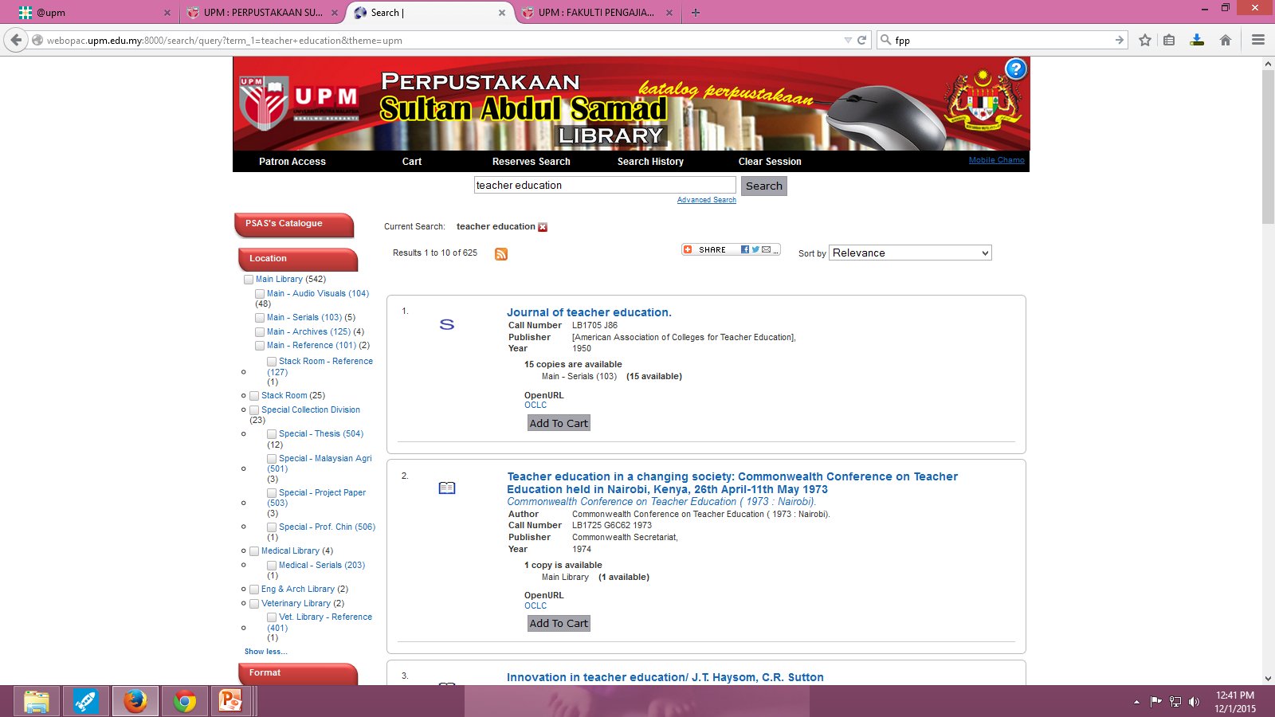
RESEARCH PROJECT PAPER
Let’s try the following term:
Teacher education.
1
2
Type search term in the browse box
e.g “teacher education”
2. Click Search
3. From the left panel, users may select by Location : e.g “Special – Project Paper”
3

Slide 3
RESEARCH PROJECT PAPER
RESULT PAGE
4. Click on “Title”’ for information details
4

Slide 4
RESEARCH PROJECT PAPER
Item Full Record
Interface
Location: Indicate the location of item
Call number: to locate the
material on the shelf
Status: to indicate either the material is available or on loan or other status

