Slide 1
A RESERVE SEARCH allows you to search for items on reserve (Special-Red Spot) by using:
HOW TO FIND A BOOK :
RESERVE SEARCH
Course ID
Title
Course Name
Instructor/
Lecturer Name

Slide 2
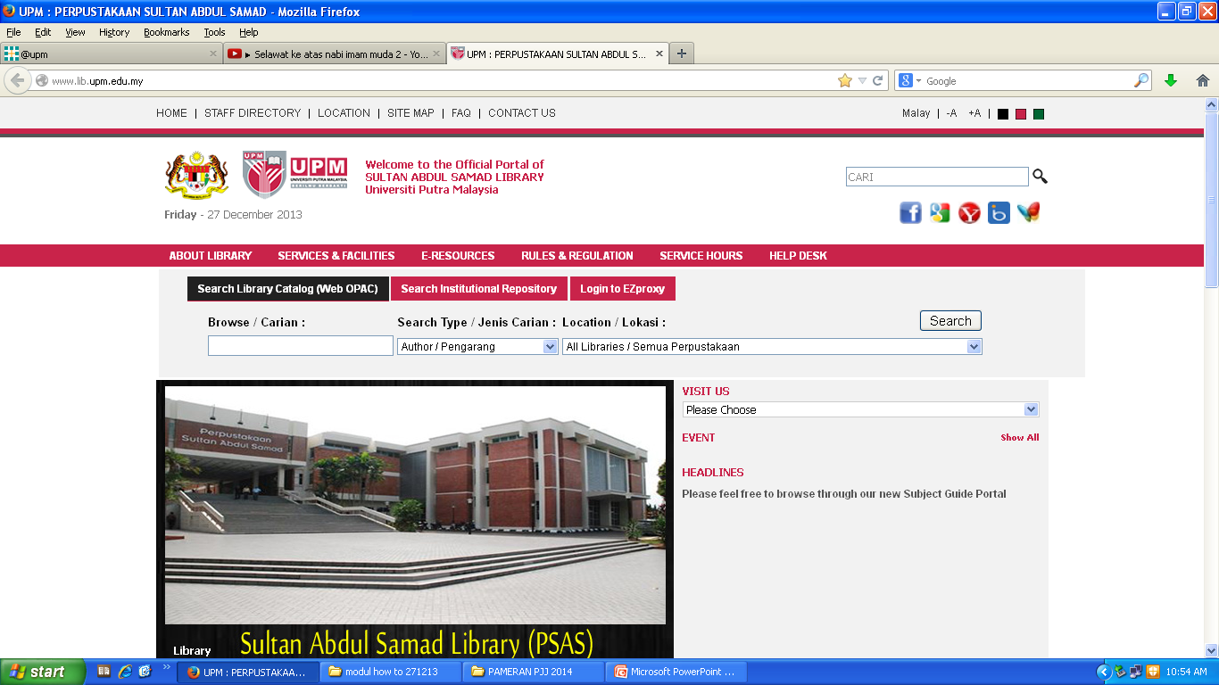
HOW TO FIND A BOOK :
RESERVE SEARCH
Click here to begin

Slide 3
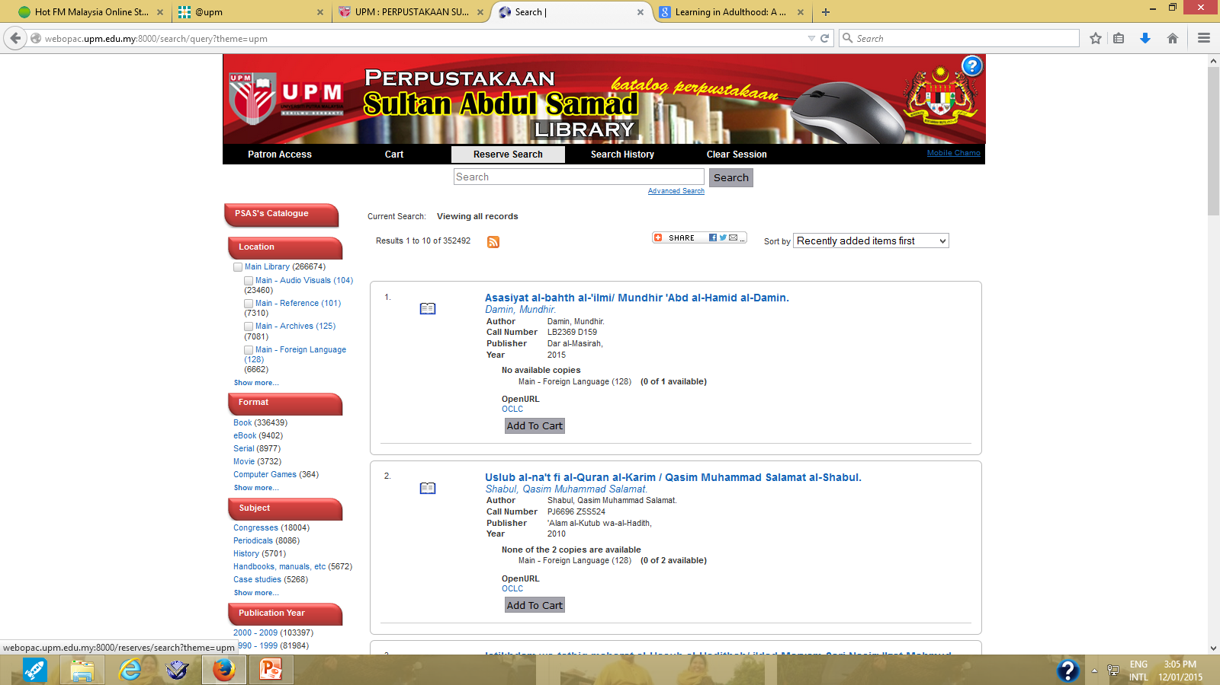
RESERVE SEARCH
Click ‘Reserve Search’

Slide 4
RESERVE SEARCH (COURSE ID)
Let’s try the following Course ID:
EDU 5437
Select “Course ID” in the search type
Type Course ID in the word box e.g. “EDU 5437”
Click the Search button
2
3
1

Slide 5
RESERVE SEARCH (COURSE ID)
Click on Course Name e.g. Teaching and Learning in Agriculture under Course ID EDU 5437

Slide 6
RESERVE SEARCH (COURSE ID)
RESULT PAGE
The Course ID “EDU 5437” is included in Course Name “Teaching and Learning in Agriculture” & Instructor Name “Ramlah Hamzah, Prof. Madya Dr.”
Click on selected title e.g. Practical Statistics for Experimental Biologists to view the information details

Slide 7
RESERVE SEARCH (COURSE ID)
Item Full Record
Interface
Location: Indicate the location of item
Call number: to locate the
material on the shelf
Status: to indicate either the material is available or on loan or other status

Slide 8
RESERVE SEARCH (COURSE NAME)
Let’s try the following Course Name:
Principles of adult education
Select “Course Name” in the search type
Type Course Name in the word box e.g. “principles of adult education”
Click the Search button
2
1
3

Slide 9
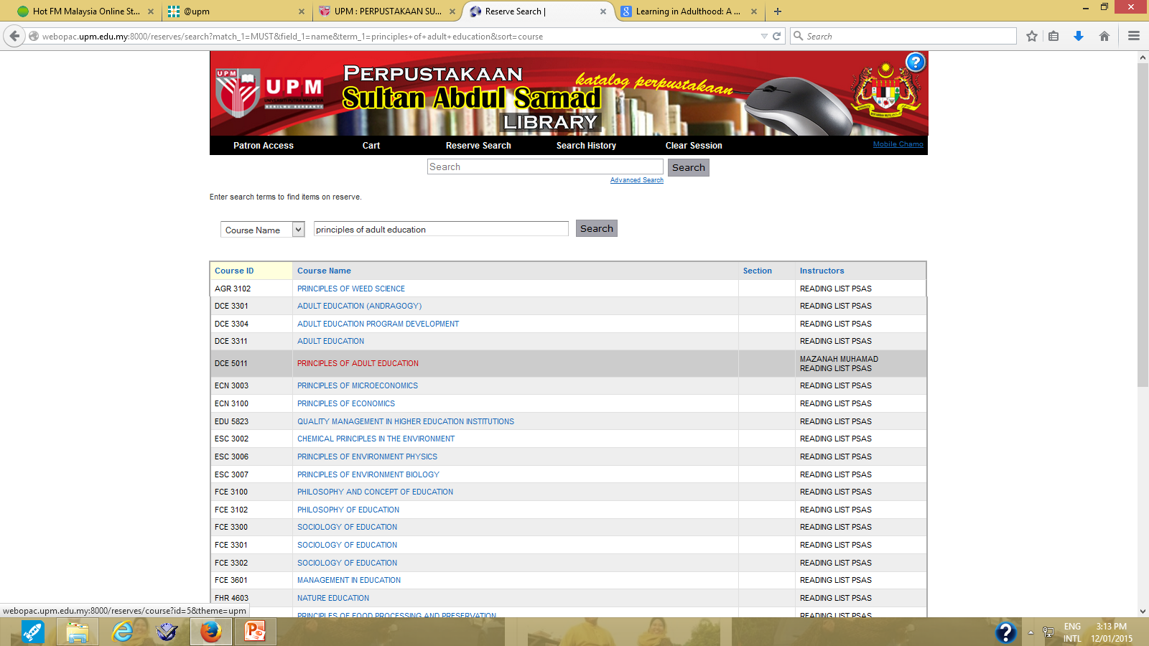
RESERVE SEARCH (COURSE NAME)
Click on Course Name e.g. PRINCIPLES OF ADULT EDUCATION

Slide 10
RESERVE SEARCH (COURSE NAME)
RESULT PAGE
The Course NAME “PRINCIPLES OF ADULT EDUCATION” is included in Course ID “DCE 5011” & Instructor Name “Mazanah Muhammad”
Click on selected title e.g. Learning in Adulthood to view the information details

Slide 11
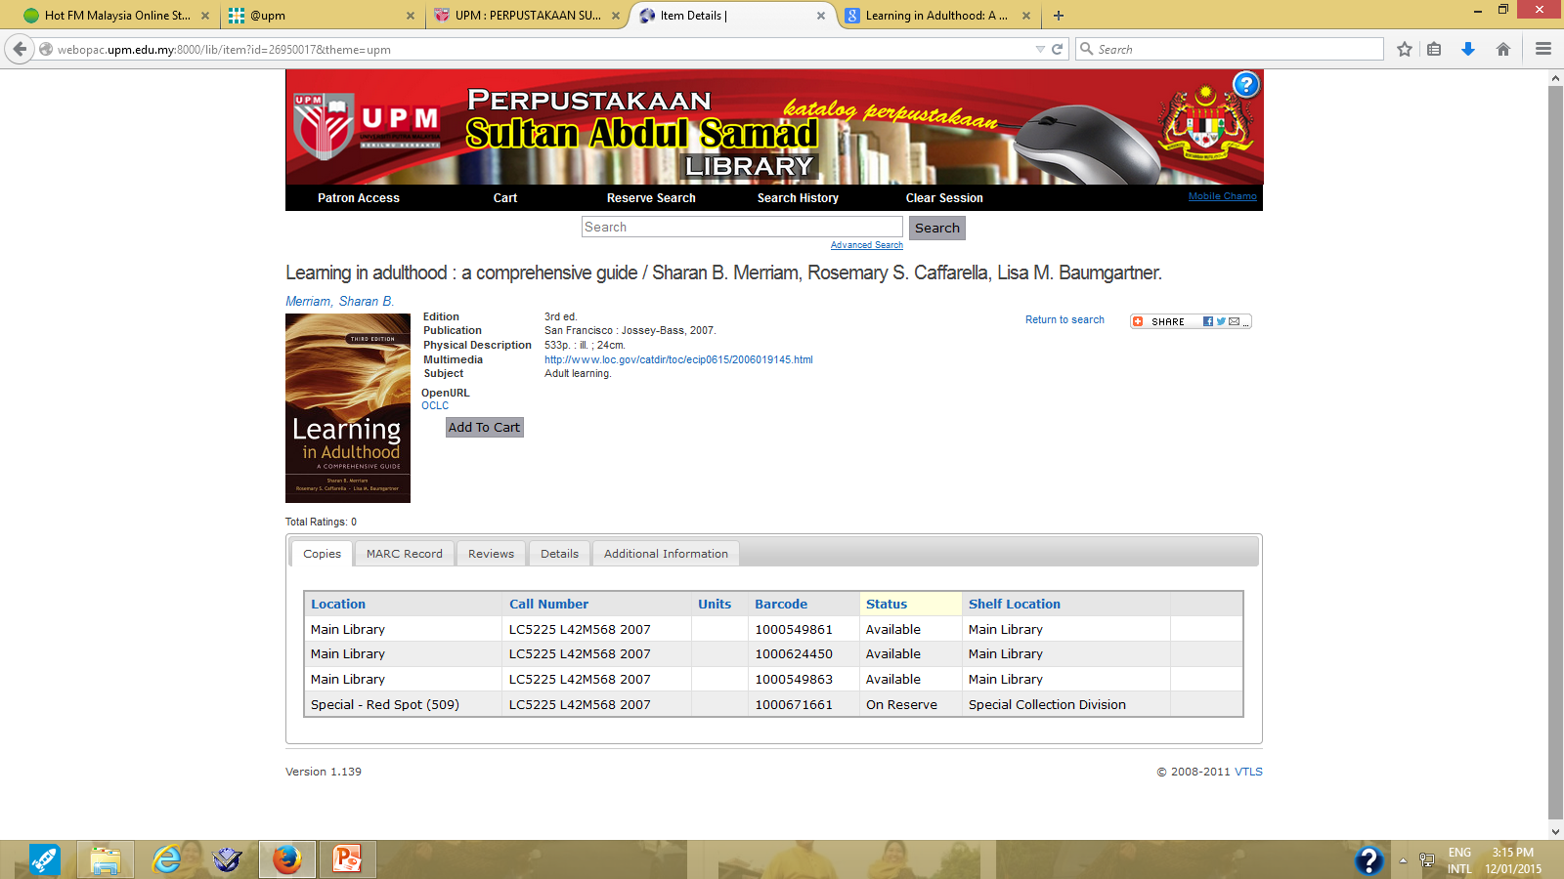
RESERVE SEARCH (COURSE NAME)
Item Full Record
Interface
Location: Indicate the location of item
Call number: to locate the
material on the shelf
Status: to indicate either the material is available or on loan or other status

Slide 12
RESERVE SEARCH (INSTRUCTOR NAME)
Let’s try the following Instructor Name:
Mokhtar Nawawi
Select “Instructor Name” in the search type
Type Instructor / Lecturer Name in the words box e.g. “Mokhtar Nawawi”
Click Search
1
2
3

Slide 13
RESERVE SEARCH (INSTRUCTOR NAME)
Click on selected Course Name e.g. EDUCATIONAL TECHNOLOGY

Slide 14
RESERVE SEARCH (INSTRUCTOR NAME)
The Instructor Name “MOKHTAR BIN HAJI NAWAWI” is included in Course ID “EDU 3034” & Course Name “Educational Technology”
Click on selected title e.g. Fotografi to view the information details

Slide 15
RESERVE SEARCH (INSTRUCTOR NAME)
Item Full Record
Interface
Location: Indicate the location of item
Call number: to locate the
material on the shelf
Status: to indicate either the material is available or on loan or other status

Slide 16
RESERVE SEARCH (TITLE)
Let’s try the following Title:
Corporate governance
Select “Title” in the search type
Type Title in the words box e.g. “corporate governance”
3. Click the Search button
1
2
3

Slide 17
RESERVE SEARCH (TITLE)
Click on title Corporate Governance to view the information details

Slide 18
RESERVE SEARCH (TITLE)
Item Full Record
Interface
Location: Indicate the location of item
Call number: to locate the
material on the shelf
Status: to indicate either the material is available or on loan or other status

