Slide 1
HOW TO FIND
RESEARCH THESIS
Click here to begin

Slide 2
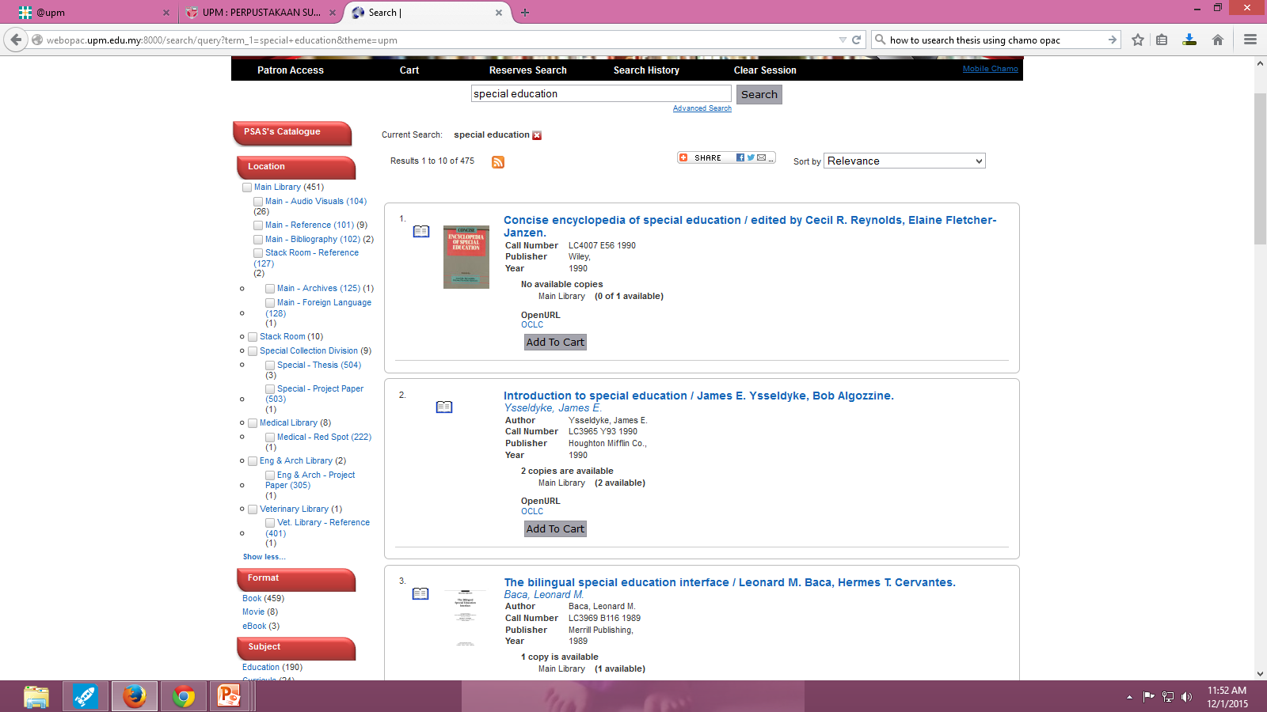
RESEARCH THESIS
Let’s try the following term:
special education
1
2
3
Type search term in the browse box e.g “special education”
2. Click Search
3. From the left panel, users may select by Location e.g “Special – Thesis”

Slide 3
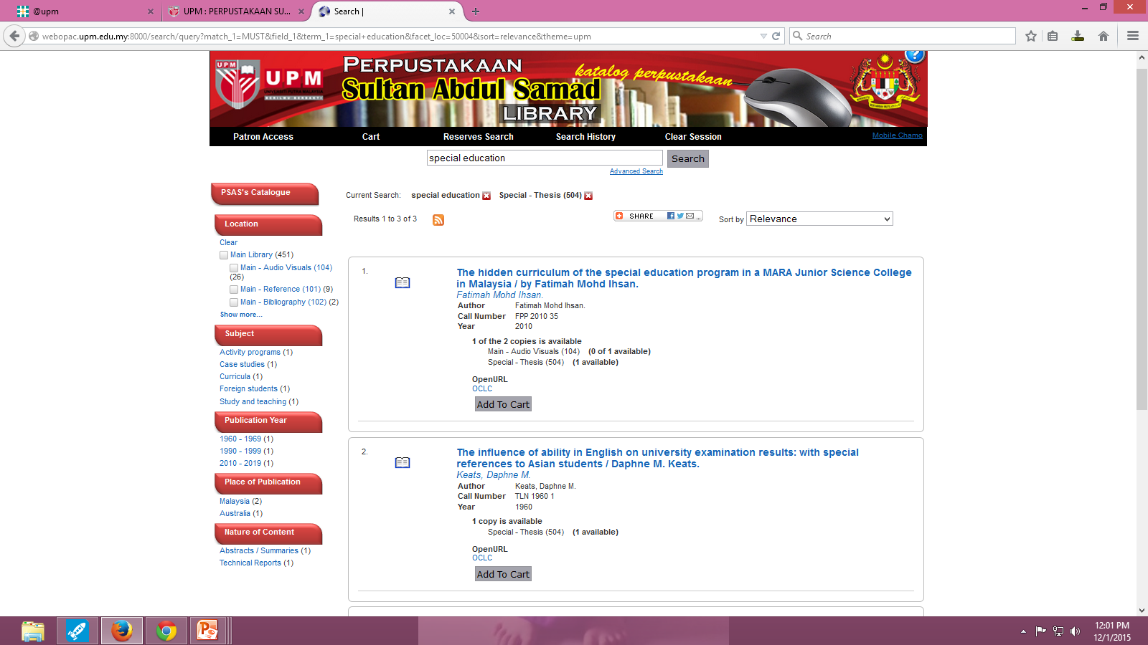
RESEARCH THESIS
RESULT PAGE
Click on “Title”’ for information details
1

Slide 4
RESEARCH THESIS
Item Full Record
Interface
Location: Indicate the location of item
Call number: to locate the
material on the shelf
Status: to indicate either the material is available or on loan or other status

