Slide 1
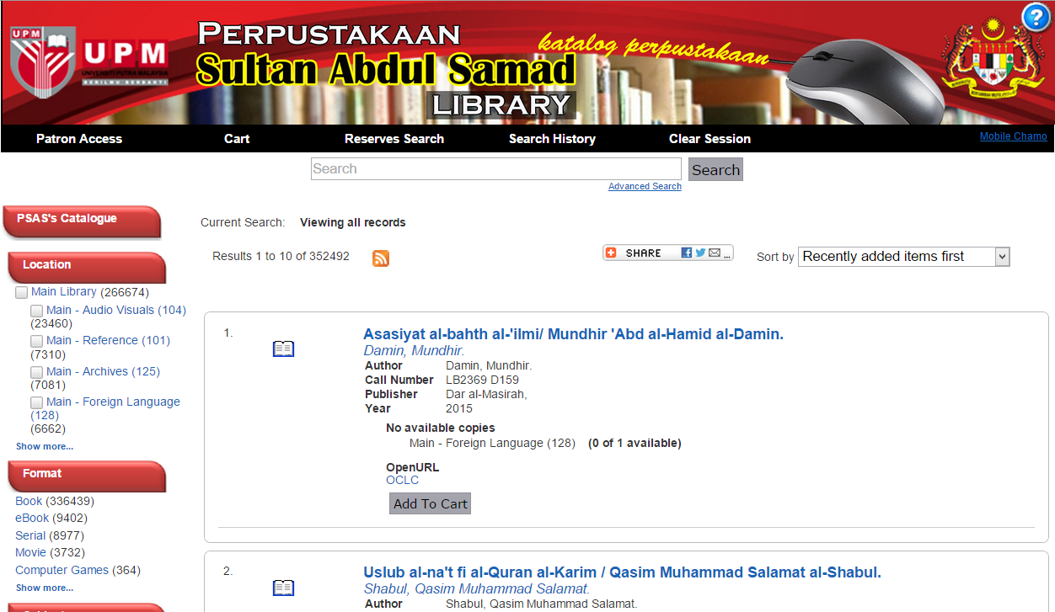
HOW TO FIND BOOK using ADVANCED SEARCH (AUTHOR)
Click here to begin

Slide 2
ADVANCED SEARCH (AUTHOR)
1
2
Let’s try the following book:
Marketing for nonprofit organizations by Philip Kotler.
3
4
Select “ Author” from the listbox.
2. Select “has all of these words” from the list box.
3. Type search term in the box.
e.g. “Philip Kotler”
4. Click Search .

Slide 3
ADVANCED SEARCH (AUTHOR)
RESULT PAGE
5. Click on the ‘title’ of the appropriate result to view information details.
5

Slide 4
ADVANCED SEARCH (AUTHOR)
INFORMATION DETAILS PAGE.
Location: Indicate the location of item
Call number: to locate the material on the shelf
Status: to indicate either the material is available or on loan or other status

Slide 5
HOW TO FIND BOOK using ADVANCED SEARCH (CALL NUMBER)
Click here to begin

Slide 6
ADVANCED SEARCH (CALL NUMBER)
1
2
Let’s try the following call number:
HD30.213 O99 2015
3
Select “Call Number” from the listbox.
2. Select “has all of these words” from the list box.
3. Type search term in the box.
e.g. “HD30.213 O99 2015”
4. Click “Search”
4

Slide 7
ADVANCED SEARCH (CALL NUMBER)
RESULT PAGE
5. Click on the ‘title’ of the result to view information details.
5

Slide 8
ADVANCED SEARCH (CALL NUMBER)
INFORMATION DETAILS PAGE.
Location: Indicate the location of item
Call number: to locate the material on the shelf
Status: to indicate either the material is available or on loan or other status

